Slide 1
Silhouette Coefficient:

Slide 2
Silhouette refers to a method of interpretation and validation of consistency within clusters of data. The technique provides a graphical representation of how well each object has been classified.
The Silhouette Score and Silhouette Plot are used to measure the separation distance between clusters.
It displays a measure of how close each point in a cluster is to points in the neighbouring clusters.
This measure has a range of [-1, 1] and is a great tool to visually inspect the similarities within clusters and differences across clusters.

Slide 3
If most objects have a high value, then the clustering configuration is appropriate. If many points have a low or negative value, then the clustering configuration may have too many or too few clusters.

Slide 4
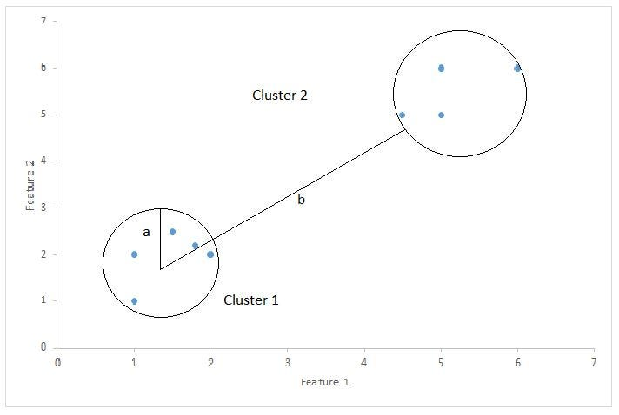

Slide 5
The Silhouette Score is calculated using the mean intra-cluster distance and the mean nearest-cluster distance for each sample. The Silhouette Coefficient for a sample is
Silhouette Score = (b-a)/max(a,b)
a= average intra-cluster distance i.e the average distance between each point within a cluster.
b= average inter-cluster distance i.e the average distance between all clusters.

